Slide 1
School of Engineering and technology
Department of Computer Science and Engineering
Arduino Project
on
ClassVitals
An RFID-Gated Multi-Sensor Smart Classroom System on Arduino Uno
Team Members
Project Guide
Aditya - 25BBTCS319
Chetan Venugopala - 25BBTCS327
Chilaka Hrushikesh - 25BBTCS328
Ratan Bahadur Mohanta - 25BBTCS347
Prof. Akshatha Bhat
Assistant Professor
Dept. of ECE,
SoET, CMRU, Bangalore.
Date: 26 / 10 / 2026
10/26/2026
School of Engineering & Technology

Slide 2
Outline
Abstract
Introduction
Objectives
Methodology
Circuit diagram
Hardware Description
Software Used
Advantages
Applications
Conclusion
References
10/26/2026
School of Engineering & Technology

Slide 3
Abstract
Fans and lights in most classrooms are switched by hand and are often left running after the room has emptied. ClassVitals makes the RFID card tap the power gate: a student taps once to enter and again to leave. While nobody is inside, the fan, buzzer and light stay off whatever any sensor reads. Once someone is inside, a DHT11, a sound sensor and an LDR decide which outputs switch on, and a 20x4 LCD shows the occupancy count, timer, sensor values and output states. Every entry and exit is also logged, so attendance comes from the same tap.
10/26/2026
School of Engineering & Technology

Slide 4
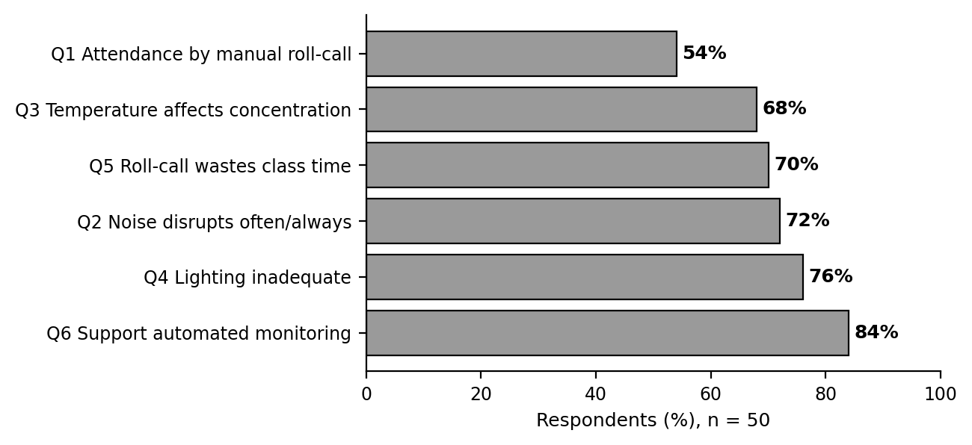
Introduction
Classroom fans and lights are usually switched by whoever walks in first, and not switched off again.
Noise, heat and poor lighting go unnoticed until they become a problem.
Roll-call attendance takes teaching time.
ClassVitals puts these jobs into one low-cost Arduino Uno circuit.
A survey of 50 students and faculty at CMR University was run before choosing any hardware.
Fig. 1 Survey results (n = 50)
10/26/2026
School of Engineering & Technology

Slide 5
Objectives
Energy saving: nothing runs in an empty room; the fan and light run only when conditions need them.
Comfort and noise alert: keep temperature and lighting within sensible limits automatically, and sound a buzzer with a warning when noise crosses a set limit.
Attendance and low cost: log each entry and exit from the same RFID tap, using common hobby-grade modules a student lab can afford.
10/26/2026
School of Engineering & Technology

Slide 6
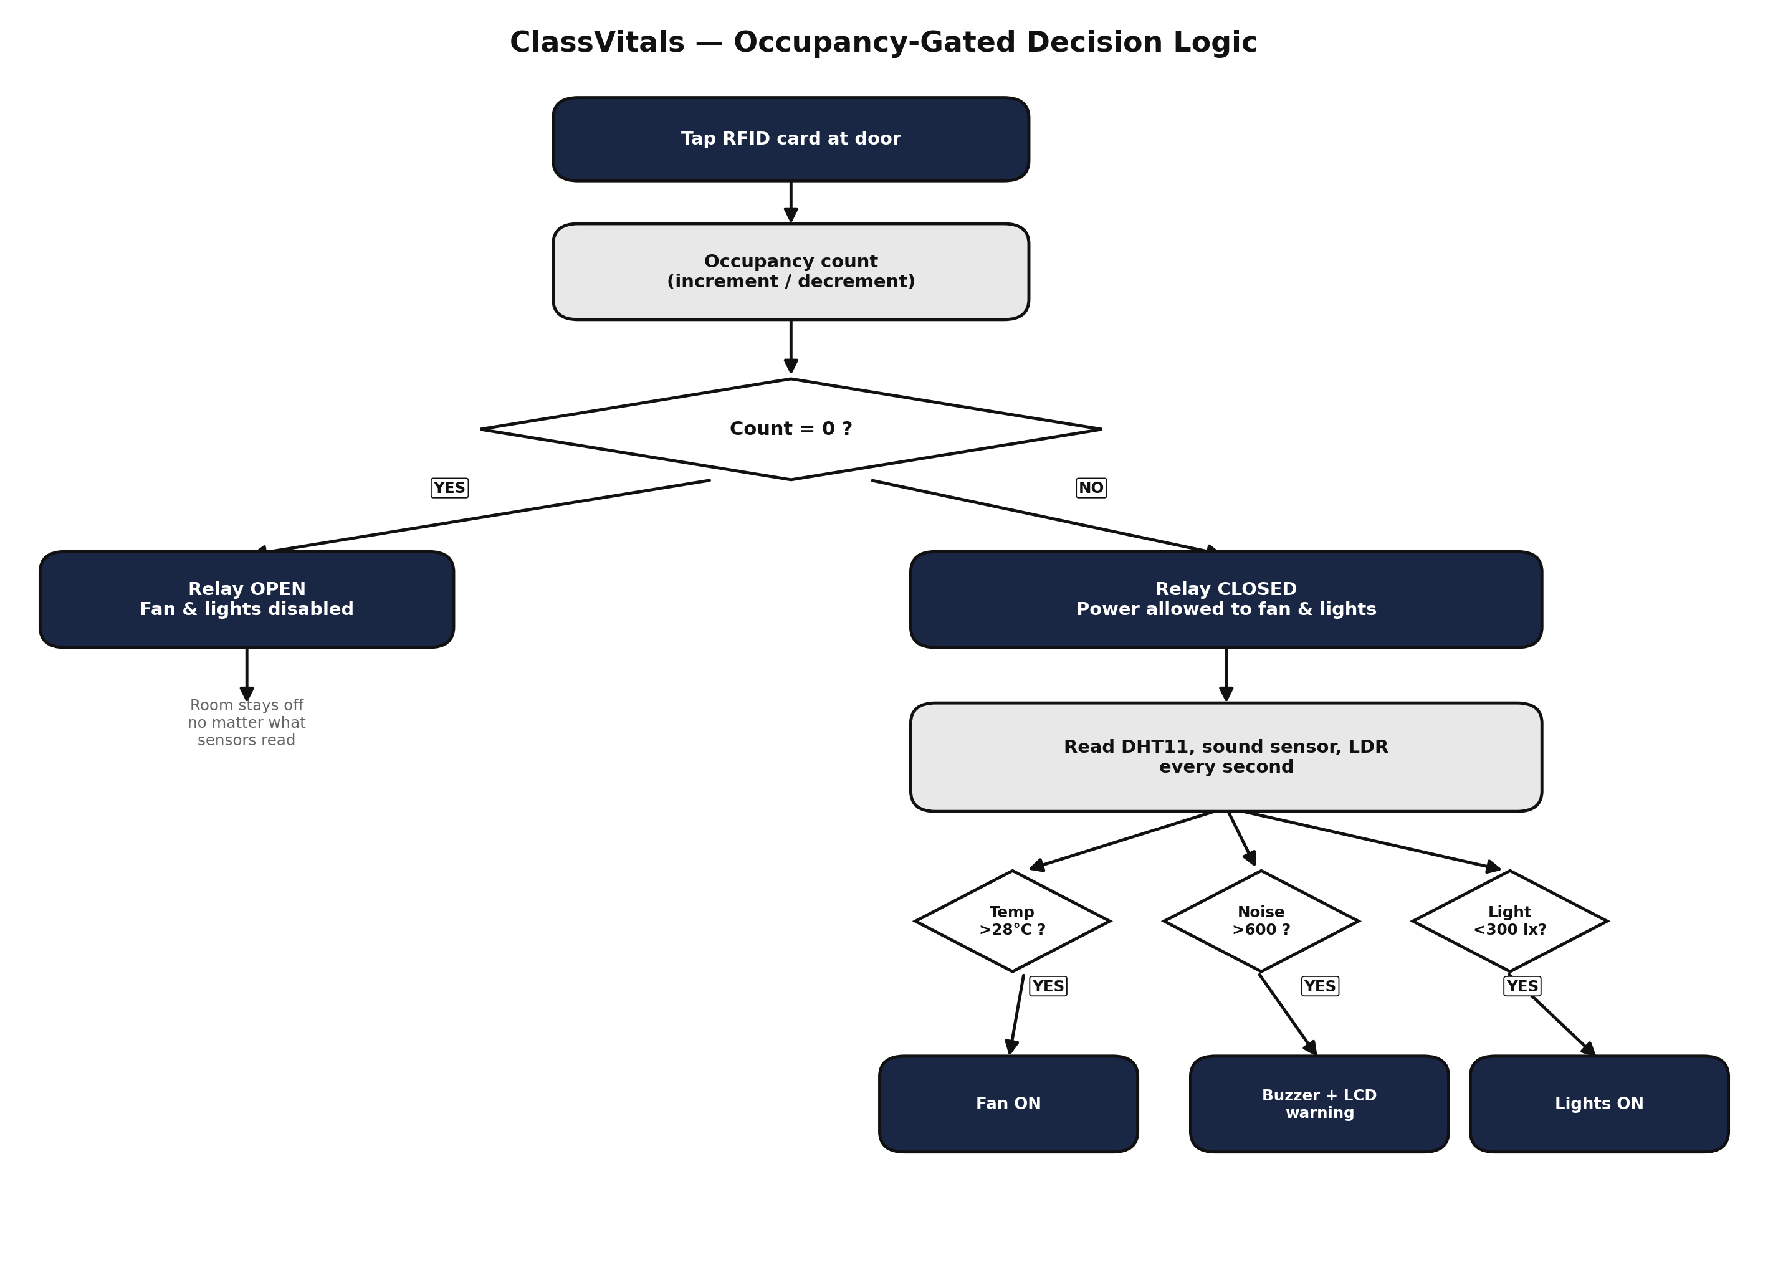
Methodology
Two layers of control:
Room gate: RFID occupancy count
Sensor checks: only act when the gate is open
EMPTY (count = 0): fan, buzzer and light forced OFF.
ARMED (count ≥ 1): fan ON above 28 °C (OFF below 27 °C), buzzer ON above 600, light ON below 300 (OFF above 330).
Exit applies at once: outputs drop when the last student leaves; timer resets.
Fig. 2 Occupancy-gated decision logic
10/26/2026
School of Engineering & Technology

Slide 7
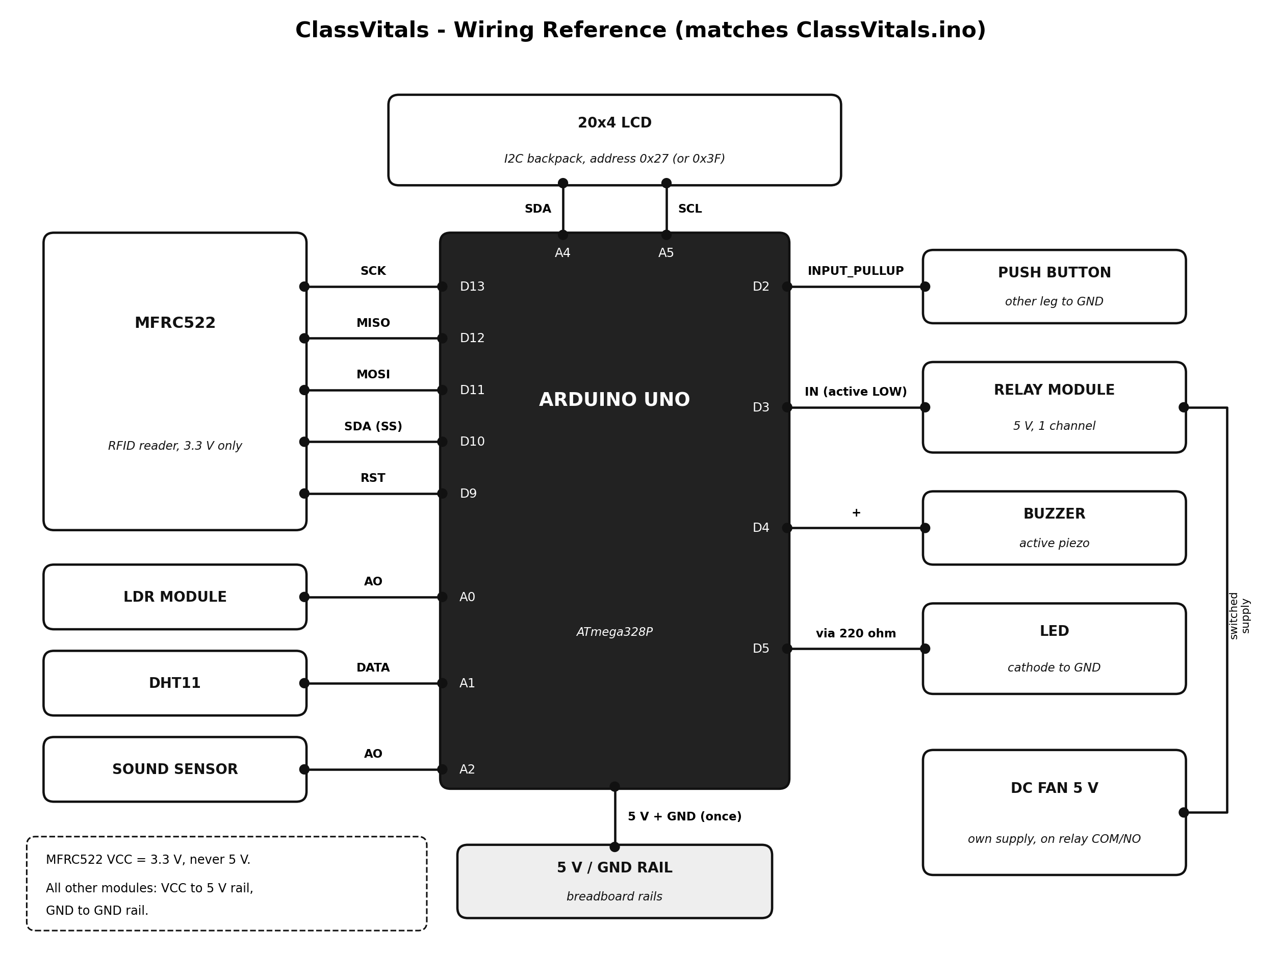
Circuit Diagram
RFID MFRC522: SPI on D9–D13, powered from 3.3 V only
LCD 20x4: I2C on A4 (SDA), A5 (SCL)
Relay (fan): D3, active LOW, own 5 V supply
Buzzer / LED: D4 / D5 (LED via 220 Ω)
LDR / DHT11 / Sound: A0 / A1 / A2
Test button: D2 to GND
Fig. 3 Wiring diagram of ClassVitals
10/26/2026
School of Engineering & Technology

Slide 8
Hardware Description
Component | Specification | Role in ClassVitals
Arduino Uno R3 | ATmega328P, 5 V | Reads sensors, decides outputs
RFID reader + cards | MFRC522, 13.56 MHz, Mifare S50 | Entry / exit tap, occupancy gate
DHT11 | Temp. and humidity, digital | Fan decision (28 °C)
Sound sensor | LM393 mic module | Noise buzzer (reading 600)
LDR module | LM393, analog out | Light decision (reading 300)
LCD | 20x4 with I2C backpack | Count, timer, values, states
Relay + DC motor | 5 V, 1 channel | Switches the fan
Buzzer, LEDs | Active piezo, 5 mm LEDs | Noise alert, light and status
10/26/2026
School of Engineering & Technology

Slide 9
Software Used
Arduino IDE: sketch ClassVitals.ino, uploaded at 9600 baud serial.
Libraries: MFRC522, LiquidCrystal I2C, DHT sensor (Adafruit) + Adafruit Unified Sensor.
Browser simulation: Tinkercad-style single-file simulation of the same decision rules.
Design choices:
Sound read as peak over 30 ms so the buzzer actually fires
1 °C hysteresis on the fan stops relay chatter
Relay set before pin becomes output: no click at power-up
Item | Value
Room gate | Count > 0
Fan | ON > 28 °C, OFF < 27 °C
Buzzer | ON > raw 600
Light | ON < 300, OFF > 330
Sensor cycle | 1 s
LCD refresh | 250 ms
Card list | 40 cards
10/26/2026
School of Engineering & Technology

Slide 10
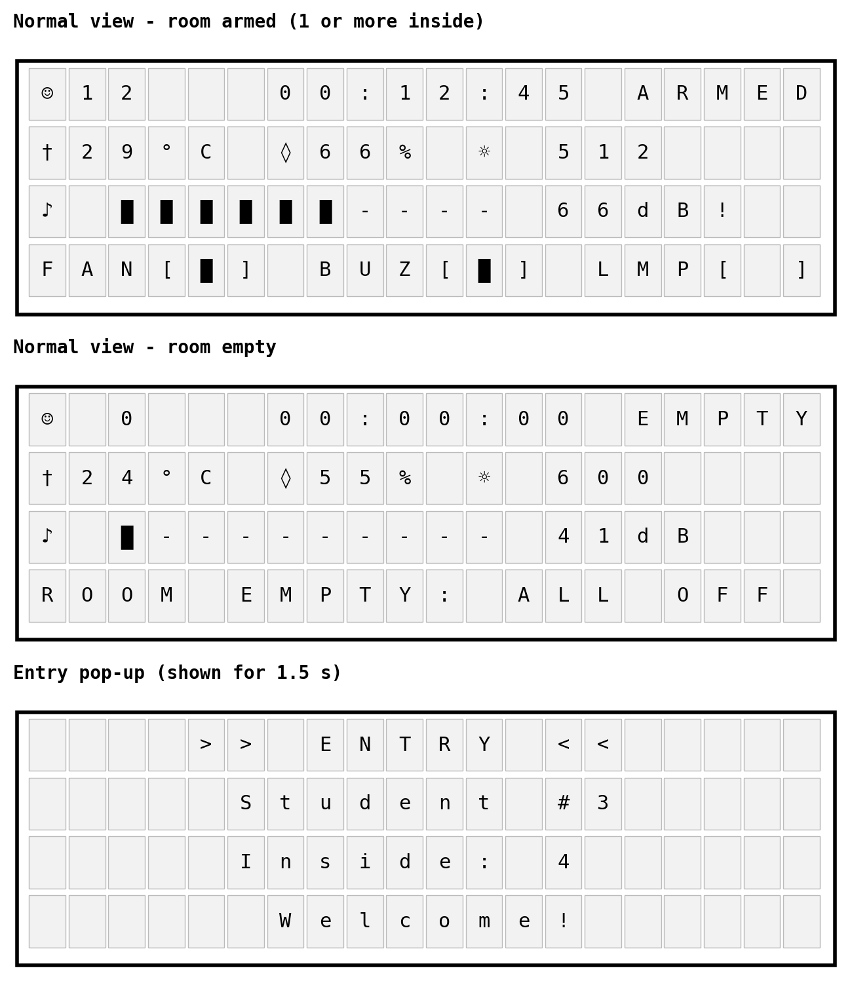
Software Used: Display and Log
Row 1: occupancy count, time occupied, ARMED / EMPTY
Row 2: temperature, humidity, light reading
Row 3: sound bar and dB (approximate mapping)
Row 4: fan, buzzer, lamp states; "ROOM EMPTY: ALL OFF"
Serial monitor: every entry and exit is logged with time, student number, card UID and count inside
Card logic: 1st scan = ENTRY, 2nd scan = EXIT; same card within 2 s counts once
Fig. 4 LCD screens
10/26/2026
School of Engineering & Technology

Slide 11
Advantages
Saves energy: the fan, buzzer and light cannot switch on in an empty room.
One tap does two jobs: occupancy gate and attendance log.
Automatic noise, temperature and light checks while the room is in use.
Low cost: common modules, no special hardware.
Hysteresis on the fan and light prevents relay and LED chatter.
Rules were checked in software over 100,000 random entry/exit steps and 193,492 sensor combinations; all matched.
10/26/2026
School of Engineering & Technology

Slide 12
Applications
Classrooms and lecture halls
Seminar halls and meeting rooms
Computer and electronics labs
Library and self-study rooms
Any room where power should follow occupancy
10/26/2026
School of Engineering & Technology

Slide 13
Conclusion
ClassVitals makes the RFID tap the switch that allows a classroom to draw power; temperature, noise and light decide what runs once someone is inside.
The design follows a 50-person survey, uses low-cost modules and gives an attendance log without a separate system.
The single-zone system is built and tested on the breadboard; only the six-zone PIR extension is pending.
Future scope: calibrate sound and light on site, six-zone PIR extension, EEPROM for the count, Wi-Fi logging with ESP32.
10/26/2026
School of Engineering & Technology

Slide 14
References
[1] https://www.electronicsforu.com/
[2] https://wokwi.com/
[3] https://www.tinkercad.com/
[4] "Energy Saving System Using a PIR Sensor for Classroom Monitoring," IEEE PowerAfrica 2017.
[5] "Occupancy Monitoring Using Passive RFID Technology for Efficient Building Lighting Control," IEEE Xplore 6353853.
[6] "IoT based Classroom Automation using Arduino," IJTSRD, vol. 2, no. 2, 2018.
[7] "Smart Classroom for Electricity-Saving with Integrated IoT System," J. Phys.: Conf. Ser. 2107, 2021.
[8] R. Want, "An Introduction to RFID Technology," IEEE Pervasive Computing, 2006.
10/26/2026
School of Engineering & Technology

Slide 15
THANK YOU
10/26/2026
School of Engineering & Technology

